Slide 1
The Square & Semi-circle of Existence
By
Sahana Mitra

Slide 2
The paper is on the experiential account of my journey.
The journey in which I was seeking something & being in the IPI course helped me to explore it further.
The outcome was the awareness of the square, its center & fringes and, how semi-circle is formed within it & slowly rises above the square.
The thoughts are reflected through the teachings of Sri Aurobindo, the Mother & Saint Kabir on our way of living & becoming in this world.

Slide 3
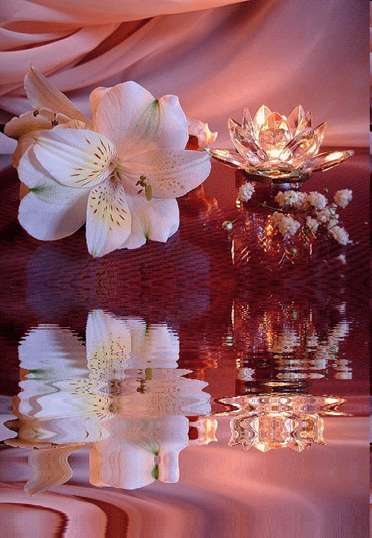
Who looks outside—dreams
Who looks inside---awakens
--Carl Jung

Slide 4
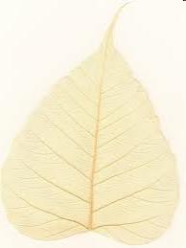
The total illusion of life came forth when the awareness dawned upon me that how much I’ve ignored my inner voice (intuition).
Reasons were pressures of growing up, pleasing others, helping others to the extent of getting exploited.
Simultaneously, there was faith and hope to reconnect with oneself. As Mother rightly quoted, “when one gets discouraged by your own faults, whatever ignorance in which one might have lived, one carries deep within oneself the supreme purity which can be translated into wonderful realization. Concentrate on what one wants to be”

Slide 5
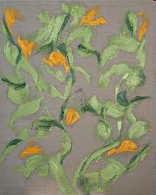
The first concept that came into being was the SQUARE OF EXISTENCE—
Includes our duties, expectations of others, societal & professional roles.
Each corner of square represent 4 roles for me-that of a daughter, a sister, a friend and a teacher.
Result was canvassing our thoughts & opinions with respect to these 4 corners. Loosing oneself completely in the square, denying our inner self or postponing its expression for future to be.

Slide 6
FRINGES OF THE SQUARE
Is built with layers of pains, the sufferings, the betrayals on one hand and friendship, happiness and success on the other hand.
The meaning of existence is realized with these fringes of what are the areas we have to work on & what is the essence behind the episodes of life.
Here is what The Mother reflected," Always circumstances come to reveal the hidden weaknesses that have to be overcome”

Slide 7
The overall result was (a) realization that there is more to experience than the mere perception (each episode to teach us a lesson) (b) the process of detachment (in form of pendulum feeling)
Life is like a story of a Jamun Tree: its only when the jamuns after ripening have fallen, we then realize their existence. Looking at the crushed jamun, we look up at the splendid beauty of the tree. The mosaic of experiences keeps attracting & repelling us against each other and the situations.

Slide 8
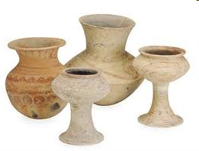
For me, the process of detachment was like pendulum feeling. On one hand, there was intense involvement & on other hand, a witness attitude. Stepping back, amidst all the things helped me to reflect where I was headed and what I wanted from life.
There was lot of confusion in midst of satisfaction and faith in divine within.
Its what Saint Kabir said,
Kache bhande se rahe juh kuhmar ka neh|
Bhitar se raksha kare, bahar chot deh||
(The potter cares for the fresh clay pot, protects from inside with his palm
And strikes from above to shape it up, cures the defects by this balm)

Slide 9
In the same square of existence, one can experience several forms of detachment. All these forms reflect half of the story.
Shamshan vairagya or Burial ground detachment
Tivra vairagya or intense dispassion
Purna vairagaya- is the lasting detachment
Similarly, Sri Aurobindo gave 3 simple steps of detachment process.
Witness attitude
State of neutral equanimity
A sense of being something separate from all that happens
Outcome is eternal & unfading happiness sustained through self knowledge & self realization.

Slide 10
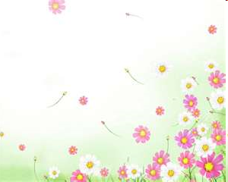
CENTER OF THE SQUARE
It was experienced by the identity which we form while relating to others (shared identity)
As Mother quoted, “others are the mirror to our identity”
This process of ‘Relating to’ & ‘learning from’ others progressed when I followed the guidance of Sri Aurobindo & The Mother in practicing
(a) Equanimous state of mind
(b) Good speech
(c) Vigilance: passive & active both are necessary as one prevents you from falling & other helps you to advance quickly
(d) Being aware of the effect of our own actions on others (inner awareness)
This all lead to movement towards semi-circle of existence (pendulum process of detachment)

Slide 11
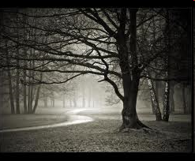
The outcome of the connection made to others was concern for others.
This can be summarized very well through Saint Kabir’s doha
“ Bari aawat dekhike, tarvar dollen lag|
Hum katte ki kuch nahi, pakheru ghar bhag||
(Seeing the wood cutter come at it, the tree does start up and say
He will fell me-let him do, but what of the birds that stay)

Slide 12
Also, an experience of peace, concern for others & centeredness within was felt during certain moments described as through MULTICOLOURED DOTS within the square. The dots of small meditative experiences like walking, cooking food, cleaning of the house.
Role of these dots: I could contribute to the welfare of the others/society but keep aspiring for connecting to inner core source.
Outcome of these dots: The source loves you, defines the world for you & never makes you feel guilty. If you feel calm & peaceful, that is your answer.
As Sri Aurobindo stated, “you come from the source, you exist from the source & someday you return to the source”

Slide 13
BUILDING OF THE SEMI-CIRCLE WITHIN THE SQUARE OF EXISTENCE
After the pendulum feeling of detachment & practicing silencing & introspection of thoughts, a strong sense of distancing from various events & people was felt in my square. It was more like standing in the middle of the semi-circle observing people equidistant from oneself & feeling same kind of love.

Slide 14
The three layered process
A continuity of the experience of semi-circle in my way of responding, awareness of consciousness in each & every act we do & the process of stepping back
Stage 1- anger, negativity if relationship turned sour or happiness & wishful thinking
Stage 2- praying for oneself & others even if something bad has happens to you through others.
Stage 3: surrendering to the divine to take care of others & yourself. Praying in general
Dropping the anger makes life meaningful & makes the transition from 1st to the 3rd phase easier.

Slide 15
Letting the disturbing thoughts pass & not responding to it for a while, this helped me to observe whether the response was desired or not.
As Sri Aurobindo puts it, “To face them with equanimity which will diminish their importance & effect”
Aim is to develop the inward strength as against the power of outward circumstances.
I truly believe is that--
What we have within us creates the circumstances outside us.

Slide 16
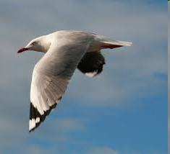
Semi circle gave me the platform to reflect on the vastness of being & to aspire for the stage where happiness & sadness mingle.
To believe strongly what one really wants as sooner or later, one will get one. Its like the old saying-don’t try to change the direction, you’ll reach where you’re destined to be”
I don’t try too hard to bring semi-circle into my life. It will come eventually, if it is meant to be.

Slide 17
Present status:
A feeling of compassionate & gratefulness for life itself & my presence. It carves us to be a person one aspires to be.
“We all are God gifts on earth and what we become is our gift to God”

